Slide 1
Welcome to My Presentation

Slide 2
Overview of Apple Inc. Company
Name :Manik Uddin
Batch : 10th
Department :English
Date :04/12/2024

Slide 3

“We believe that business, at its best, serves the public good,”.

Slide 4
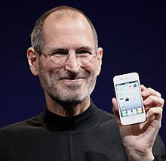
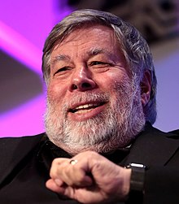
Introduction
Legal Structure & Governance
Apple Computer Company (1976–1977) Apple Computer, Inc. (1977–2007)
IPhone
Apple’s core product is the iPhone. The popular smartphone is among the top five smartphone vendors in the world.
 | Steve Jobs
Mac
Apple’s personal computer business is built around the Mac and includes its MacBook laptops and the iconic iMac desktop computers.
iPad
When Apple launched its iPad in 2010, it quickly became the first commercially successful tablet computer to hit the market.
Steve Wozniak

Slide 5
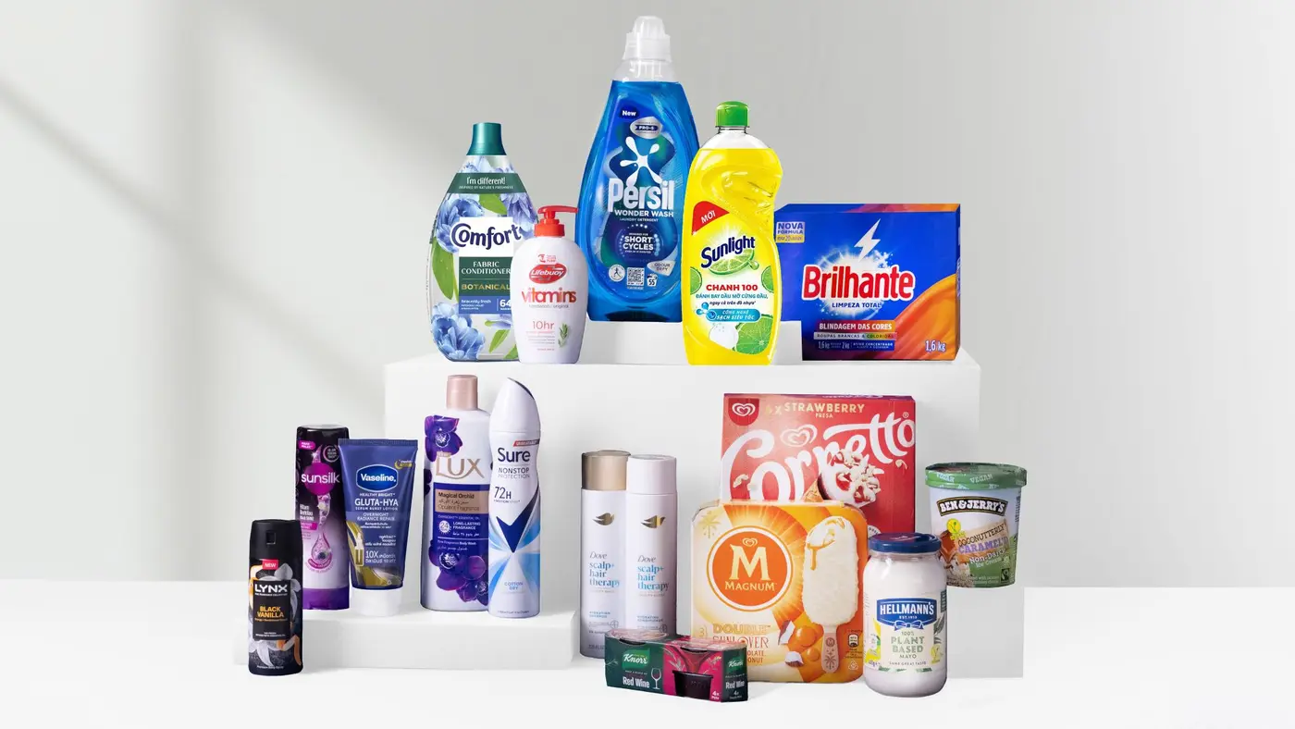
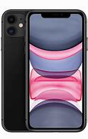
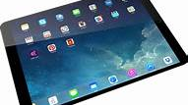

Product and services
Apple

Slide 6
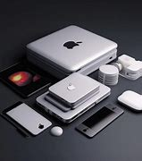
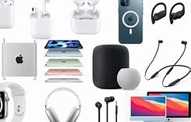
Apple Products
Popular Brands:
Iphone,Imac,Laptop
Products:
Smartphone,Laptop,Macbook

Slide 7
Laptop and Gagette
Popular Brands:
Iphone,Softwewe,Hardwere

Slide 8
Apple
MACBOOK
LAPTOP
IPHONE

Slide 9
Apple Data Analysis
Category | Turnover/ Billion | USG/ %
LAPTOP | 6.5 | 7.1
IPHONE | 7 | 5.6
MACBOOK | 6.7 | 3.2
IPAD | 6.3 | 3.3
SOFTWERE | 4.6 | 0.6
Total | 31.1 | 19.8

Slide 11

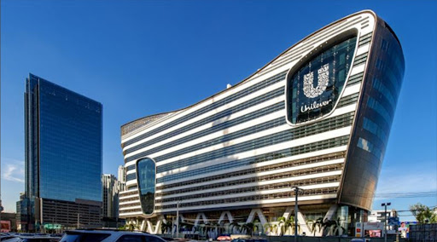
Solid Revenue Growth
Turnover & Growth
APPLE achieved a turnover of €31.1 billion in the first half of 2024, marking a 2.3% year-over-year increase. This growth highlights its ability to maintain steady market momentum.

Slide 12
Segment Insight
Segment & Insight
The Beauty & Wellbeing segment led growth with a turnover of €6.5 billion and a 7.1% USG. Personal Care and Nutrition segments reported strong performance, indicating Unilever’s commitment to health and personal hygiene needs. The Ice Cream segment experienced modest growth, reflecting market challenges.

Slide 13

Profit &
Mergins
Segment & Margins
The Beauty & Wellbeing segment led growth with a turnover of €6.5 billion and a 7.1% USG. Personal Care and Nutrition segments reported strong performance, indicating Unilever’s commitment to health and personal hygiene needs. The Ice Cream segment experienced modest growth, reflecting market challenges.

Slide 14
THANKS!

